Slide 1
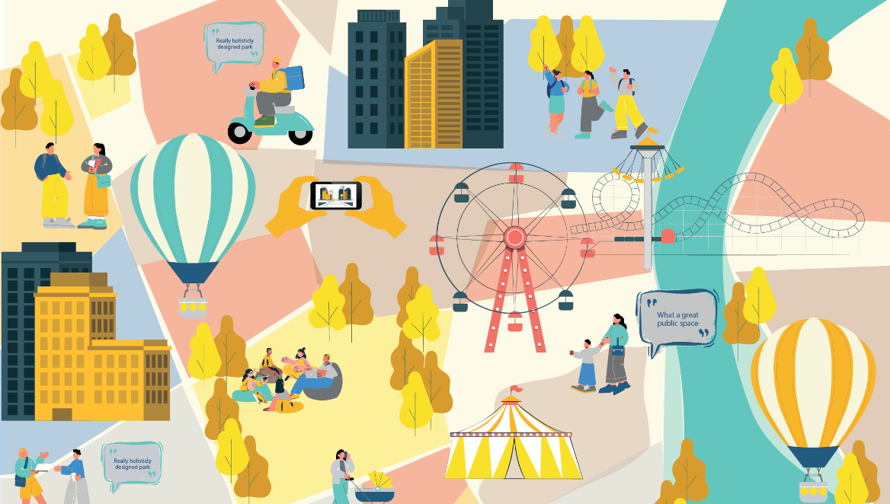

Gender sensitive infrastructure
- Capturing the linkages between infrastructure and women’s workforce participation
Prepared by :
Initiated by :

Slide 2
Objectives, outputs, and outcomes
Objective
Outputs
Outcomes
To establish if there is a relationship between availability, accessibility and quality of infrastructure related to mobility and participation of women (in lower income communities) in the workforce.
To understand to what extent does design and implementation of public infrastructure have a role to play in women's workforce participation.
To influence design standards, manuals, guidelines, toolkits on mobility/ public space design to be gender inclusive for workforce participation
Primary survey findings on non-negotiable and negotiable infrastructure design features that influence women's workforce participation in Indian cities.
Design and implementation of infrastructure to enhance user comfort and safety enables women to participate in the workforce
Key takeaways and recommendations enabling design and implementation of gender intentional mobility infrastructure that enables higher participation of women in the workforce.
* Note: The study is qualitative in nature. Further validation of input pointers will be required for detailed design standards.

Slide 3
Background
Women in the workforce
Women and girls make up nearly 50% of India's population but contribute to only 17% of the national GDP.¹
Urban-rural disparity - While the latest version of the Periodic Labour Force Survey (PLFS) released by the Labour Bureau, shows a considerable increase in women participation, there's a stark difference between rural and urban areas. In the last 5 years, rural female labor force participation rate (LFPR) increased by 24.6 points (from 24.6% to 36.6%), while urban female LFPR only increased by 8.9 points (from 20.4% to 28.3%).
The gender gap - In the 15-59 age group, urban female LFPR (2022-23) is only 31.2% compared to 81.9% for males. This varies across states, going as low as 13.6% for Uttar Pradesh. This massive disparity indicates severe obstacles to women's participation in the urban workforce.
Social and cultural norms: As per PLFS 2021-22, the key reason reported by females for not being in the labour force is child-care/ personal commitments in home making (44.5%). An additional 4% do not work because their job is not at a convenient location, and 3.4% due to social reasons. Thus, rising household income demand works as disincentive for female participation in labour market. Non-availability of work at a convenient location was also among the top reasons (0.6%). The urban-poor women fall under the intersection of these challenges and, hence, are disproportionality challenged.
World Bank. Women in India's Economic Growth. 2018
https://www.itf-oecd.org/sites/default/files/docs/urban-travel-behaviour-gender.pdf
https://www.theguardian.com/global-development-professionals-network/2016/oct/13/why-arent-we-designing-cities-that-work-for-women-not-just-men

Slide 4



Role of mobility infrastructure
Understanding barriers
Existing government schemes aimed at supporting women's caregiving responsibilities, safety in public space have not resulted in a proportionate increase in workforce participation, especially for urban women. Hence, barriers in workforce participation must go beyond caregiving, domestic, and social reasons.
At the same time, parallel studies prove that women experience cities differently as they commute.
Understanding mobility patterns
Women travel differently: Women are less likely to travel alone than men and more likely to travel with children, shopping, and/or with elderly, owing to caregiving responsibilities. This makes women time poor. However, general design guidelines for urban infrastructure in the country do not accommodate female travel patterns2. Local and global studies that do acknowledge the gender-gap generally seek to provide high-level solutions than specific and implementable recommendations. ​
Trip chaining, Longer travel distances
Women’s travel patterns are impacted by safety, caregiving responsibilities resulting in combining trips and taking longer routes
Threat of gendered violence
The threat/ experience of sexual violence when commuting in Indian cities deters women from commuting through certain routes.​
Dispersed destinations
But, majority of women’s labour in the country is heavily skewed towards the self-employment and casual labour and their destinations are likely to be dispersed across the city.​

Slide 5
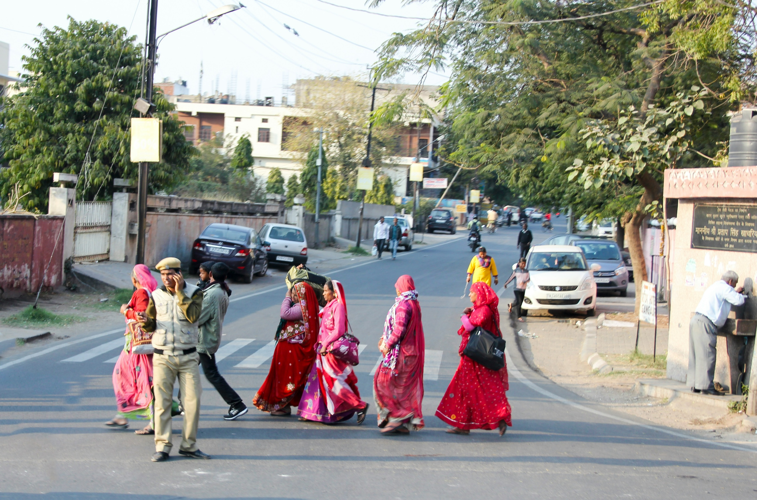
Vision
Despite these evidences, there is no COMPREHENSIVE design instruction for the development of infrastructure to aid women's workforce participation. Additionally, while there are recommendations, there are no mandates ensuring gender inclusivity in infrastructure
The study explores the role of infrastructure, especially mobility infrastructure, in impeding or enabling women’s workforce participation.​ By identifying and addressing barriers faced by low-income groups, the study aims to identify solutions that benefit all income groups.

Slide 6
What current frameworks/ guidelines exist?
Click here for the full list
We have reviewed 9 documents – 5 national and 4 global level guidelines and policies.
Of the 5 India- specific guidelines/ toolkits/ policy briefs, 2 focus on policymaking and implementation process for gender-responsive urban mobility and public spaces. 2 focus on infrastructure design and service delivery, of which 1 document provides clear indicators and design recommendations for mobility infrastructure and public transport systems. 1 document provides a participatory tool for assessing perception of gender safety in public spaces.
Of the 4 global guidelines, all focus on incorporating gender inclusivity and gender-focused decision making in the design and implementation of infrastructure.
Of all 9 documents reviewed, all focus on gender inclusivity in the design and implementation of infrastructure and meeting the current needs of women in terms of mobility and safety. No guidelines specifically focus on women's workforce participation, although 4 out of the 9 (3 from global and 1 from India-specific) explore the role of infrastructure in infrastructure in women empowerment, and employment opportunities.
No document specifically focuses on the barriers posed by infrastructure in enabling workforce participation.
No document provides clear instructions for design of infrastructure with a key focus on enabling workforce participation (only high-level recommendations on safety is provided; the ITDP document provides clear design instructions on gender-specific mobility and service delivery)
Next steps : We chart existing recommendations across frameworks, revealing critical gaps. This mapping compels us to ask: "What's missing?"
* Note: Detailed list of reviewed literature in annexure.

Slide 7
Element/ category | General design guidelines |  | Gender related guidelines (World Bank, Safetipin, ITDP) |  | What's missing? Considerations in existing norms
 | National guides - URDPFI + NBC + IRC | Tender SURE | Travel patterns/ considerations | Recommendations
General considerations | 1. (Gender sensitive planning GSP recommendation) As per IRC Guidelines 103‐2012, a level of service B or C is recommended. All footpaths should include and specify a dead zone, an uninterrupted walking zone and a multi‐utility zone for street furniture etc. 2. (GSP recommendation) Women are disproportionately affected by poor quality pedestrian infrastructure and increased walking distances. Walkable blocks should be promoted by limiting block sizes, providing direct, shortest non‐motorized transport routes or pedestrian public right of ways. |  | 1. Travel with dependents. 2. Use public transportation and NMT as the main modes of transport. | 1. Improve walking and cycling infrastructure to ease first and last mile connectivity for women, girls, and persons of other genders based on universal design guidelines. 2. Well-designed obstruction-free pavements enable women and others to walk comfortably. 3. Atleast 80% of city roads, with universally accessible, shaded footpaths with minimum 3.5m width or Level of Service B. 4. At least 80% of women/girls living within 500m walking distance of public transport in the city and metropolitan region, with a frequency of at least 6 schedules per hour. 5. Women and girls’ walking trips are less than 15 minutes. | What infrastructure facilities (pelican signals, raised crosswalks, reflective signs etc) impact travel route choices? Would they choose a longer route for any of them? How is the current pedestrian infrastructure in their route to work/ trip chain/ limiting their potential?
Footpath | 1. Min. width = 1.8m. 2. Width ranges from 1.8m to 4.0m depending on pedestrian traffic, uni/ bi-directional movement and adjacent land-use. For commercial/ mix-use areas , min. width = 2.5m. 3. Manholes, trees, benches, utility boxes and other potential obstructions should be placed outside the path of travel along a continuous line. | 1. Min. width = 1.5m, max. width = 3m. 2. Height above carriageway = 150mm - 250mm, kerb ramp slope 1:10. 3. MUZ - min. width = 0.4m. 4. Bollards to stop two wheelers, dist. between bollards = 1.2m to 1.5m. |  | 1. Min. width = 1.5m, must be entirely free of obstructions. For commercial areas, the clear width should be at least 2.5 m. | To what extent do walkable footpaths impact travel routes/ travel time for women? To what extent does provision of shaded pathways impact travel route choices? How does shaded footpath enable better trip-chaining for women?
Click here for the full list

Slide 8
How are we adding to existing frameworks?
Our study first examines if infrastructure has any significant role to play in women's workforce participation, particularly urban poor women. It then explores specific barriers posed by infrastructure in enabling workforce participation, aiming to extract inputs leading to clear design instruction/ recommendations.
Key features of the study are -
Focus on barriers in workforce participation for urban women from low-income communities, where the average household income is less than 4 lakhs per year.
The study focuses on three layers of qualitative inputs for a comprehensive approach –
  validating general design recommendations from existing toolkits/ guidelines pertaining to public infrastructure & design recommendations
  gathering input on specific design requirements for infrastructure enabling workforce participation, specifically focusing on urban-poor women
  Examining the role of existing infrastructure-based schemes and policies enabling women's workforce participation and gender safety in public space*
Focus on the local context – the study covers four cities across four Indian regions. The city selection criteria are linked to infrastructure availability and quality, and availability and degree of implementation of infrastructure schemes enabling women's workforce participation.

Slide 9
Research framework
Workforce participation barriers fall across different themes. However, the research framework limits itself to infrastructure-related themes, particularly focused on mobility, caregiving responsibilities outside the home, and safety in public spaces. These are drawn from the afore-mentioned research reviews.
Thematic barriers to women's workforce participation (sourced from PLFS, ILO survey, reviewed literature) | Infrastructure categories under select themes | Specific mobility infrastructure elements reviewed
Social norms – women are required to take up the burden of caregiving and household work; women do significant unpaid work that doesn't get counted.
Societal perceptions – belief that it is unacceptable for a woman to have a paid job outside the home
Lack of appropriate and accessible jobs – unskilled women lack access to respectable jobs that allow them to participate in the workforce in addition to caregiving duties | Accessibility and convenience - Providing accessible and convenient transport options with clear signage and seamless connections. | Walking infrastructure Cycling infrastructure IPT and feeder buses Bus stops Public transport Distance to care giving facilities- school, Anganwadi, market etc. Public toilets Street lighting Eyes on the streets
Time poverty + commuter comfort – ability to work is difficult because women may have to travel longer distances, without access to preferred mode of transit, or travel in poor conditions | Commuter comfort - Enhancing comfort with shaded footpaths, continuous, levelled walking infra, well-lit stops, and basic facilities.
Time poverty - Burden of domestic and caregiving responsibilities fall on women, making them “time poor." | Time poverty - Reducing travel time with efficient routes, frequent services, and integrated transport systems.
Gender safety | Safety and security - Ensuring women's safety through surveillance, lighting, policing, and secure infrastructure.
 | Health and hygiene - Maintaining cleanliness and hygiene with well-maintained, accessible public toilets and clean streets.
Infrastructure related themes

Slide 10
Research methodology
1
2
3
4
5
City selection
4 cities – 1 each from N/S/E/W regions of India.
* Detailed criteria mentioned in slide 5.
Community selection
Select 3-4 localities in each city, based on income and current quality of public infrastructure, with additional layers of crime and safety for final selection.
FGD composition
Select the following typologies of urban poor women for each FGD with a mix of age and job types
Women who work in a job of their choice
Women who work in a job but would prefer to work elsewhere
Women who don’t work
FGD surveys
2 FGDs in each city, with 2 additional for larger cities – total 10 FGDs
8 women selected for each Focus Group (total 163 women participated in the pre-screener)
Final research report
Analysis of findings and listing out potentials and opportunities of findings
Recommendations based on findings on specific improvements needed to increase workforce participation

Slide 11
City selection
Criteria
Assessment of 1-2 major urban centres across 36 Indian states and UTs, with respect to -
  Existing urban female working population percentage
  15 parameters related to schemes and policies enabling women workforce participation and safety – structured under mobility, care economy, and safety schemes (refer framework on slide 7).
A scoring system is created for the assessment and parameters are evaluated across states. Taking values for urban India as the baseline, a positive 1 score is given for city/state-level values that are above the baseline and negative 1 is given for values below the baseline value. The final city scores are a sum of these positive and negative scores across [15 + 1] selection parameters.
Local knowledge and interest is considered as a filter for final selection.
Final cities are selected as a mix of cities that are doing well and those that are not.

Slide 12



City selection
Criteria
Parameters for selection are given below. Along with this, existing urban female working population percent is also considered as a criteria.
Local knowledge and connection is considered for final selection.
Mobility-related schemes
Care economy related schemes
Safety/ visibility-related systems
Schemes | Indicator
Public transport safety schemes – free bus/ bus marshal | Availability
Schemes | Indicator
Swachh Bharat Mission – SLWM | No. of urban women per LWM operational centre
 | No. of urban women per SWM operational centre
Ayushman Bharat Health and Wellness Centres | No. of operational centres
Schemes | Indicator
Female police presence | Women police/ 10,000 women
Community policing | States/ cities having unique schemes for women safety
Safe city project - Nirbhaya fund | Availability
Crime stats | Crime rates against women
Women Help Line (Mission Shakti) | No. of complaints registered per working women
Street lighting policy (UJALA & SLNP)​ | % coverage/ unit area
Sakhi Niwas – working women hostels scheme | No. of urban women per operational SN
One-stop centres | No. of urban women per operational OSC
Anganwadi service scheme | No. of urban women per operational ASSP
Rajiv Gandhi crèche scheme | No. of urban women per operational RGCSP
E-Shram (portal for unorganized workers) | Total women registrations in non-agricultural sectors in lakhs, CITIES
Click here for the full-list

Slide 13
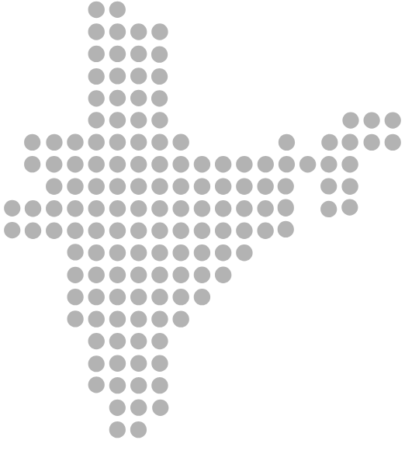
City selection
* Note: While both Kolkata and Guwahati score less on the availability of infrastructure and schemes, our priority is Guwahati due to existing presence and local knowledge.
Median city score is 2/16.
Final list of cities
We have selected two high-performing and two low-performing cities, from across 4 geographic regions in the country.
2
1
Guwahati
Delhi
Though small in size/population, it has a healthy male/female WPR. Performs well with respect to infrastructure but poorly all across.
Presents a unique case of extreme positive and negative trends. Has a very low male/female working population ratio to begin with.
0/16
-2/16
3
Mumbai
Performs well in execution of mobility schemes and is moderately low in all others.
4
Bengaluru
4/16
Ranks highly in all categories, especially public transport safety and crime safety, and moderate in others.
4/16

Slide 14
Area and community selection
Criteria
The objective is to select settlements/areas where we find urban poor women, who work/don't work and live in areas with poorer infra/services to maximise understanding of the decisions made at the edges of quality/service provision.
Community selection is done based on spatial analysis of neighbourhoods w.r.t. the following layers -
Income – based on percentage of households with less that 3 lakh/yr income and/or percentage of slum population.
Coverage of road network and public transport network – based on a combination of - 1. peripheral areas of city limits, and 2. central areas with poor access to public transport.
Street lighting – based on ward-level ratings and reports produced by other organisations such as Janaagraha, Safetipin, MDPI, Open-city etc. and primary land-use.
Crime reports – based on number of non-domestic gendered-crimes reported.
NOTE 1: Neighbourhoods with lower income and poor availability and quality of infrastructure are selected. Gendered crime data, where available, is considered as an additional criteria for selection.
NOTE 2: The following slides give a shortlist of communities from which we will be selecting
2 FGDs per city + 2 overall.

Slide 15
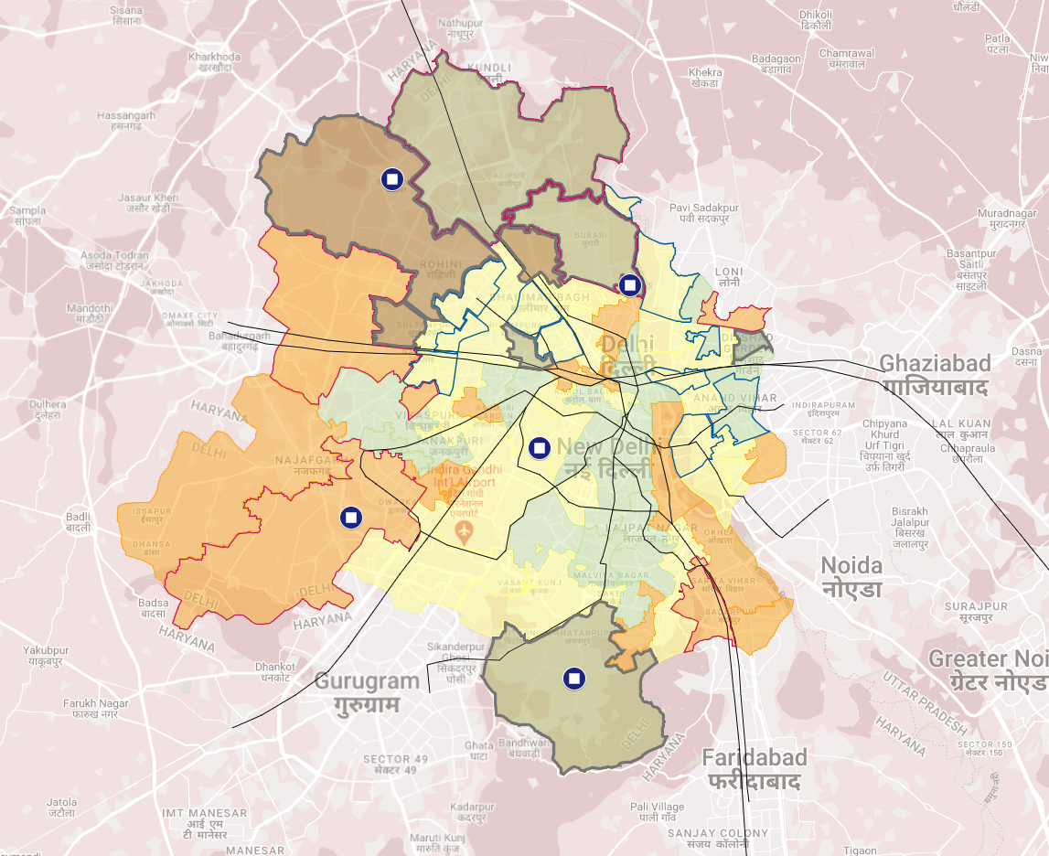
Area and community selection
Delhi
a. Shabad Dairy
Low-income groups
Poor public transport access
High gendered crime
b. Wazirpur
Low-income groups
Poor street lighting
High gendered crime
c. Nazafgarh
Low-income groups
High amount of unused land
Poor street lighting
a
cb
Legend
c
High income
Low income
Urban roads
Highways
Street lighting – low lighting index
Street lighting – high lighting index
High gendered crime
Link to map - Delhi map

Slide 16
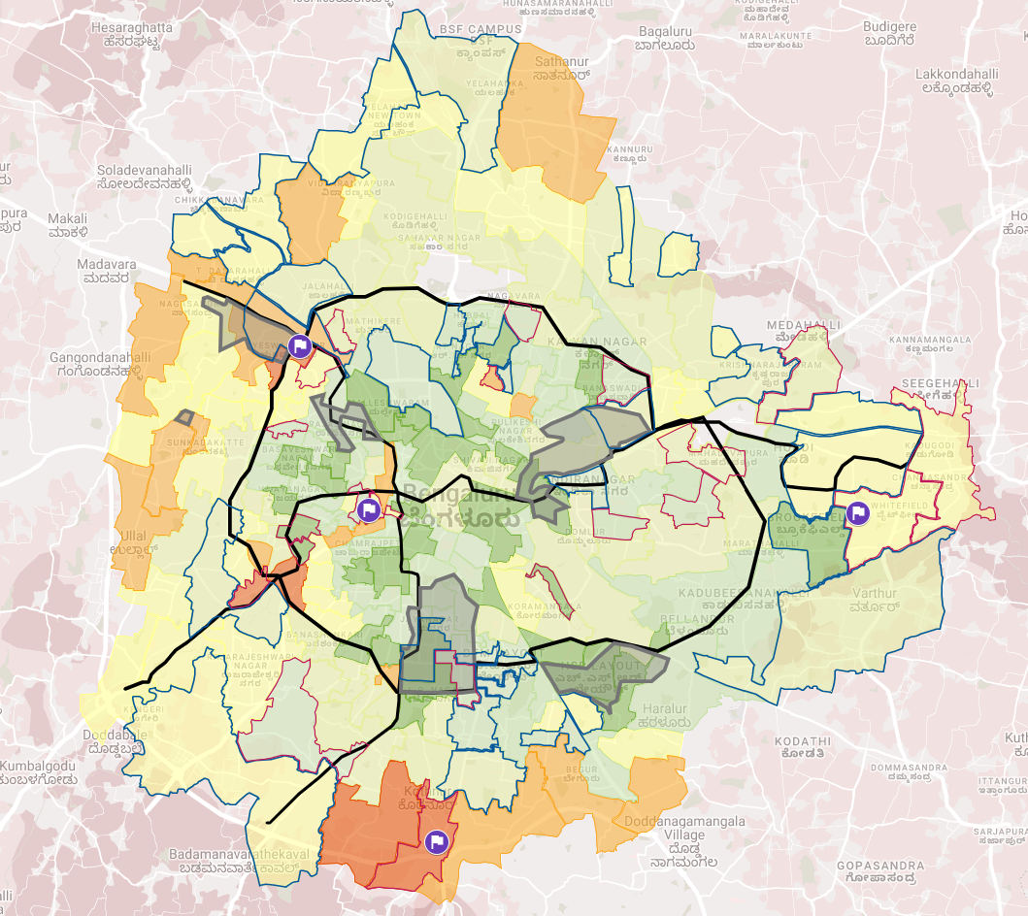
Area and community selection
Bengaluru
a. Peenya Industrial area
Low-income groups
Poor street lighting
High compound walls
High speed traffic
b. Binnypet
Low-mid income groups
Poor street lighting
High crime rate
c. Anjanapura
Low-income groups
Lack of public transport
Poor street lighting
d. Whitefield
Lack of public transport
Poor street lighting
Poor quality of roads
a
b
c
Legend
High income
Low income
Urban roads
Highways
Street lighting – low lighting index
d
Street lighting – high lighting index
Link to map - Bengaluru map
High gendered crime

Slide 17
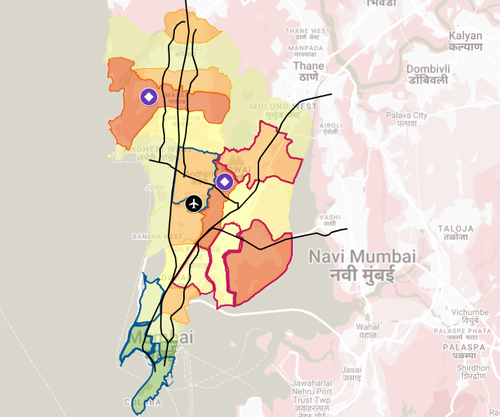
Area and community selection
Mumbai
a. Saki Naka
Low-income groups
Poor street lighting
High compound walls
High speed traffic
b. Malad
Low-mid income groups
Poor street lighting
High crime rate
b
a
Legend
High income
Low income
Urban roads
Highways
Street lighting – low lighting index
Street lighting – high lighting index
Link to map – Mumbai map
High gendered crime

Slide 18
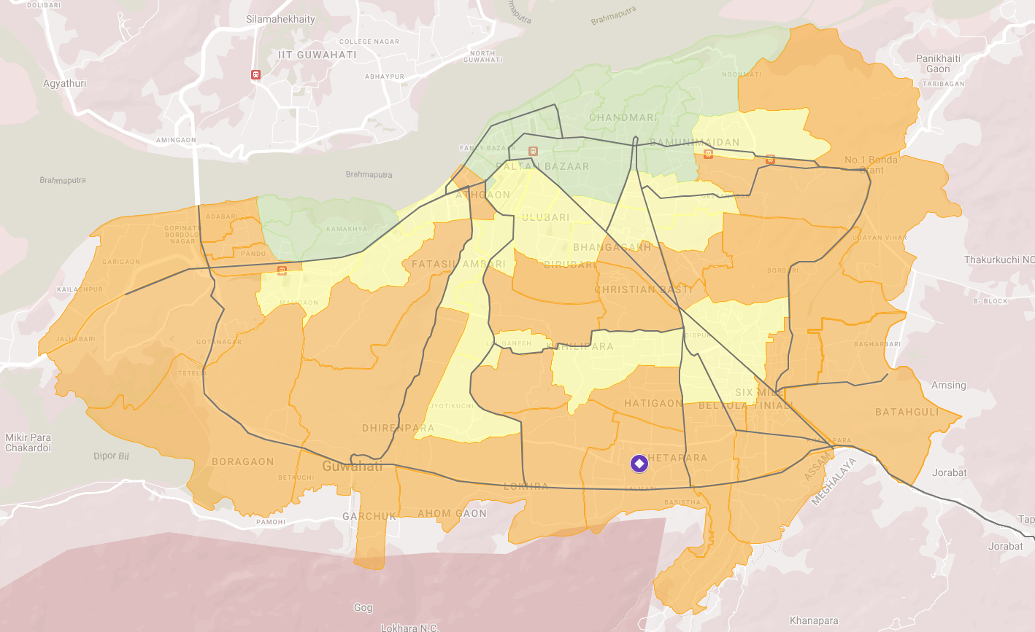
Area and community selection
Guwahati
a. Bhetapara
Low-income groups
Lack of public transport
High traffic speed/volume
Poor water quality
High crime rate
Legend
High income
a
Low income
Urban roads
Highways
Street lighting – low lighting index
Street lighting – high lighting index
High gendered crime
Link to map - Guwahati map

Slide 19
Focus group discussions
FGD composition
A quantitative pre-screener survey was conducted across the 10 selected neighbourhood across in 4 cities. A total of 163 women participated in the pre-screener, across the three categories - Women who work in a job of their choice, women who work in a job but would prefer to work elsewhere, women who don’t work. The final Focus Group Discussion participants were selected to ensure a diverse mix of circumstances to the largest extent possible. The achieved sample is given below.
City | Dates | Locations within the city | Languages | Category 1: working where they would like to | Category 2: working but not where they like to | Category 3: not working
Bengaluru | 14, 21, 29 Nov 2024 | 1. Binnypet (old) 2. Nallurahalli, Whitefield (old) 3. Peenya Industrial area (new) | Kannada, English | 8 women | 8 women | 8 women
Delhi | 25-26th Nov 2024 | 1. Nazafgarh / Delhi Cantoment (O) 2. Shabad Dairy, Bawana (N) 3. Wazirabad, Timarpur (N) | Hindi | 8 women | 8 women | 8 women
Guwahati | 27th Nov 2024 | 1. Kala Pahar, 2. Bhetapara (N) 3. Amingaon | Assamese, Hindi | A mix of Category 1 (4 women) + Category 2 (4 women) |  | 8 women
Mumbai | 24th Nov 2024 | 1. Saki Naka 2. Malad | Hindi | A mix of Category 1 (4 women) + Category 2 (4 women) |  | 8 women
10 FGDs with a total of 80 women across 4 cities, and 3 working categories between 14th - 29th November 2024

Slide 20
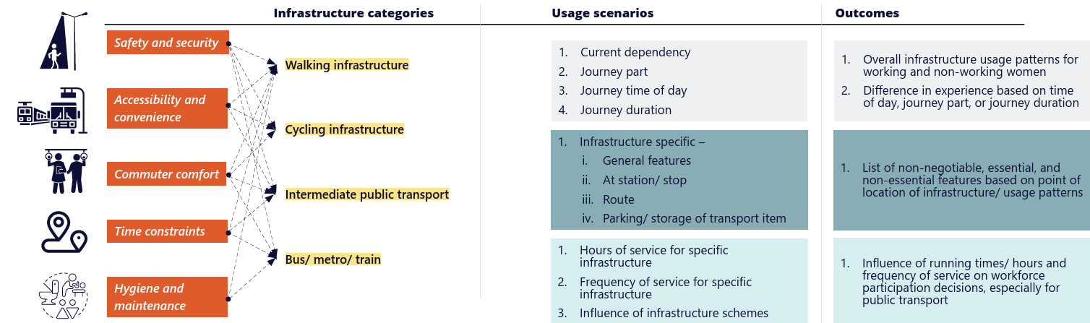
Focus group discussions
FGD survey design
The survey question schedule follows the thematic areas identified in this study. Across thematic area, key infrastructure elements are identified under - walking infrastructure, cycling infrastructure, intermediate public transport, public transport . The four infrastructure groups are further classified into specific elements and scenarios that comprehensively cover all infrastructure parameters that can potentially influence women's workforce participation. The line of enquiry proposed in the survey aims to establish -

Slide 21
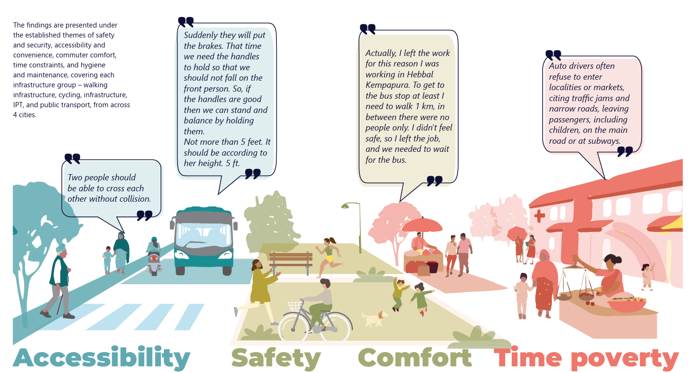
Key takeaways
Health

Slide 22
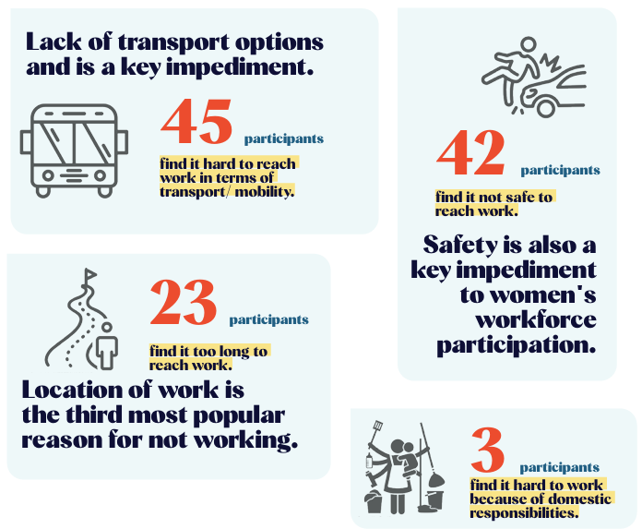
Key takeaways
Q: Does infrastructure have, at all, a role to play in impeding or enabling women's workforce participation in Indian cities?
163 respondents participated in the pre-screener, of which 64 participants were unemployed. Reasons for not working were recorded from these 64 participants.
Full list given in Annexure
Lack of infrastructure is a key impediment.
Safety is also a key impediment to women’s workforce participation.
Location of work is the third most popular reason for not working.
*Reasons for not working of non-working women

Slide 23
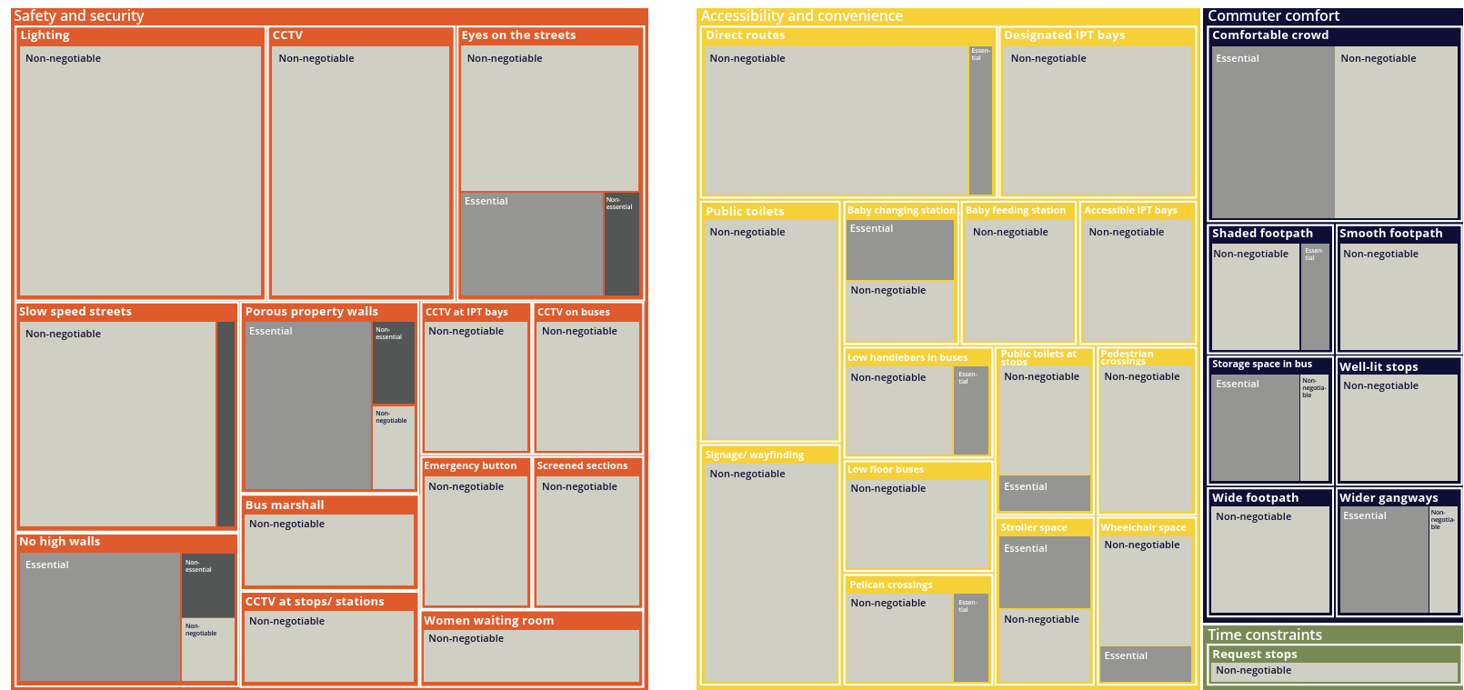
Non-negotiable, essential, and nonessential infrastructure
Weighted necessity of infrastructure elements in enabling women's workforce participation, classified as per thematic areas.

Slide 24
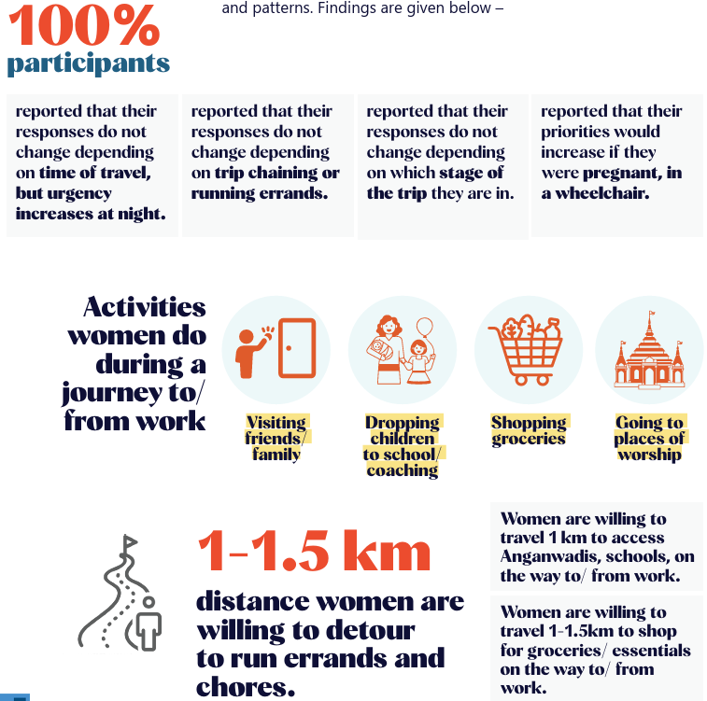
Key takeaways
Q: Do other variables such as journey duration, time, part of the journey etc. impacted their mobility needs and patterns?
Activities women do during a journey to/ from work
distance women are willing to detour to run errands and chores
*Variables impacting mobility needs and patterns

Slide 25
Key takeaways
Takeaway 1: Infrastructure has a strong role to play in women's workforce participation choices in Indian cities.
Recommendation 1: Include infrastructure as a key parameter in Periodic Labour Force Surveys
While this study was qualitative in nature, a total of 80 participants across 4 cities, the findings from this study highlight the necessity of a survey of larger scale – made possible through PLFS.
45/64 respondents selected lack of accessible transport options as they key reason to not participate in the workforce.
42/64 respondents cited lack of safety as the key reason to not work.

Slide 26
Key takeaways
Takeaway 2: Good quality, gender-intentional walking infrastructure is crucial to women's workforce participation decisions.
Recommendation 2: Update national level guidelines on urban roads such as IRC guidelines to include gender-intentional design standards for footpaths, aimed at enabling women's workforce participation.
Recommendation 3: Mandate design, implementation, and maintenance guidelines on gender-intentional urban roads across states and cities.
While the lack of quality walking infrastructure does not directly inhibit women from workforce participation, it impacts safety and time constraints for working women, especially when accompanied by children and elderly.

Slide 27
Key takeaways
Takeaway 3: Designing for accessibility and commuter comfort is imperative to ensure women participation and remain in the workforce.
Recommendation 4: Comprehensive surveys to capture the anthropomorphic and comfort needs for women across different demographic and socio-economic profiles.
Well designed wayfinding and signages have the potential to significantly reduce travel time.
Similarly, designing for commuter comfort such as providing wider gangways in buses, lower handlebars, low-floor buses ensure women are able to travel comfortably for longer distances
This study provides a baseline for the type of comfort and accessibility needs for working and non-working women. Further surveys that comprehensively capture the diverse needs of women in the labourforce across demographic and socio-economic groups is needed.

Slide 28
Key takeaways
Takeaway 4: Public transport connectivity is key to ensure women's workforce participation. Free bus schemes work, but first and last mile connectivity is crucial.
Recommendation 5: Plan for comprehensive end-to-end connectivity, and amp fleet size.
Findings from this survey highlights the need to think of first and last mile connectivity in conjunction to free bus schemes, and increasing the coverage of bus and metro rails to encompass larger areas – especially for urban poor women in Indian cities.
Working women from all four cities have reported an average of 1 hour and 30 minutes as viable traveling time. For journeys beyond this, working women from Bengaluru consider changing jobs, even accepting lower salaries to reduce commute time.

Slide 29
Key takeaways
Takeaway 5: Safety is
non-negotiable for all women; especially when considering participating in the workforce.
Recommendation 6: Set planning and design standards to ensure safety from the perspective of women in labour force.
Recommendation 7: Ensure compliance of schemes and policies on women's safety.
42 out of 64 unemployed women identified safety as the key reason for not working. This research critically highlights how lack of safety can impede women in participating in the workforce. It also gives actionable inputs on design and implementation of infrastructure to ensure safety.
Land-use has a crucial role to play when designing for safety. Ensuring active nodes around streets, especially for first and last mile connections is crucial. There also no design standards and specifications for high property walls abutting streets.

Slide 30
Annexure

Slide 31
Links to existing literature
Click here for the full-list
Guidelines |  | Agency, Year | Objectives | Indicators/ recommendations
India-specific
1. | Toolkit for Enabling Gender Responsive Urban Mobility and Public Spaces | World Bank, 2022 | Create a framework to assess gaps in policies and systems in gender aggerated data. | Mobility patterns b/w men & women & barriers across transport journey, safety perception, gaps in implementation of principles of inclusive design.
2. | Women and Transport in Indian Cities | ITDP, 2018 | Create a Gender Mobility Plan (GMP) to assess gender responsive transport indicators, and benchmarks at the city level that fall within the framework of CMP. | CMP indicators, street network, safety perception, pedestrian infrastructure, cycling network, design of bus network & transit stations, etc.
3. | She Rises & Safety Audit | Safetipin, 2023 | Identifies the elements of cities that can improve the domestic/ care-related burden on women, (preventing workforce participation) | Public spaces –lighting, pavements, eyes of street, toilets; Services- housing schemes, hostels; public transport – NMT network, lighting toilets etc.
Global
1. | Infrastructure for gender equality and the empowerment of women | UNOPS, 2020 | Looks at gaps in infrastructure systems that affect working/studying women. | Energy, transport, water, solid waste heath, education – infrastructure & implementation barriers
2. | Selected stocktaking of good practices for inclusion of women in infrastructure | OECD, 2021 | Explores policy challenges in mainstreaming gender into infrastructure and proposes a framework for incorporating gender considerations at each stage of the public investment process. | Case-studies from different countries analysis impact w.r.t scale and timelines of projects
3. | Enhancing gender equality in infrastructure development – ADB | ADB, 2023 | Identifying infrastructure-related monitoring indicators and tools in achieving gender equality (in alignment with G20 principles). | Affordability, convenience and security indicators in different sectors – transport, water & hygiene, energy, land rights etc.
4 | Her City | UN-Habitat, 2022 | Provides a toolbox for mainstreaming youth, gender and socioeconomic perspectives through participatory planning. | Supporting urban development from a girl’s perspective, Guiding urban actors to implement projects trough a step-by-step methodology, Providing an open and digitally accessible platform for all, Facilitating an ongoing dialogue between professionals and citizens.

Slide 32
Annex
City selection sources
1. | Urban female working population | https://apc01.safelinks.protection.outlook.com/GetUrlReputation
2. | Male/female urban working ratio | https://mospi.gov.in/sites/default/files/publication_reports/AR_PLFS_2022_23N.pdf
3. | Streetlighting policy (UJALA and SLNP) | https://slnp.eeslindia.org/
4. | Sakhi Niwas - Working women's hostel scheme | https://wcd.php-staging.com/women/sakhi-niwas-working-women-hostel
5. | One-Stop Centre Scheme | https://wcd.nic.in/schemes/one-stop-centre-scheme-1
6. | Anganwadi services scheme | https://wcd.nic.in/sites/default/files/ar-2-211E_merged.pdf
7. | Rajiv Gandhi creche scheme | https://wcd.nic.in/sites/default/files/Funtional%20Creche.pdf
8. | Women gig worker platforms - Sakha/ Taxshe cabs, Amazon all women delivery stations | https://olawebcdn.com/ola-institute/women-platform-economy.pdf 2. https://yourstory.com/herstory/2021/11/amazon-india-launches-fifth-all-women-partner-delivery-station , https://www.aboutamazon.in/news/operations/northeast-india-gets-its-first-all-women-delivery-station-by-an-amazon-delivery-partner
9. | E-Shram (portal for unorganized workers) - women registrations in non-agricultural sectors | https://app.powerbi.com/view?r=eyJrIjoiNTRjOGEwMmEtYmJlMC00NGZkLWJkNDItNTgwZTA2MzBkZWNlIiwidCI6IjA2ZjUzMmJmLTk3NTItNGVjNi04Y2Y4LTIzYTM3YmM2ZDQ2MSJ9
10. | WASH scheme for public toilets/ drinking water facilities - Swachh Bharat Mission Urban | https://sbmurban.org/swachh-bharat-mission-progess
11. | Solid waste managements - Swachh Bharat Mission Urban | https://sbmurban.org/swachh-bharat-mission-progess
12. | Ayushman Bharat Health and Wellness Centers | https://ab-hwc.nhp.gov.in/Home/Implementation_hwc_state
13. | Female police presence | https://bprd.nic.in/page/data_on_police_organization_dopo
14. | Community policing - unique schemes for women safety | https://bprd.nic.in/uploads/pdf/202212280402094192979CommunityPolicingforWomen.pdf
15. | Safe city project - Nirbhaya fund | https://safecity.mha.gov.in/Downloads.aspx
16. | Crime stats - crimes against women | Volume 1 - https://ncrb.gov.in/crime-in-india-year-wise.html?year=2022&keyword
17. | Women Help Line (Mission Shakti) - complaints registered in 2022-23 | https://pib.gov.in/PressReleasePage.aspx?PRID=1910101

Slide 33
Annex
Community selection sources - ward data
1. | Delhi income groups | https://www.researchgate.net/publication/248974192_Mapping_Urban_Poverty_for_Local_Governance_in_an_Indian_Mega-City_The_Case_of_Delhi/figures?lo=1&utm_source=google&utm_medium=organic
2. | Delhi street lighting | https://safetipin.com/wp-content/uploads/2016/01/delhi_a_safety_assessment_2016.pdf
3. | Delhi gendered crime | Research paper - https://www.qeios.com/read/I9NNFW.6
4. | Delhi working women's hostel and special bus service | https://delhitravelhelp.in/Ladies-Special.aspx , https://wcd.delhi.gov.in/wcd/working-women-hostels
5. | Bengaluru income groups | https://www.purepaaniindia.com/2018/01/17/income-patterns/ ; census 2011
6. | Bengaluru street lighting | https://www.janaagraha.org/resources/ward-performance-report/
7. | Bengaluru gendered crime | Study - https://safetipin.com/wp-content/uploads/2020/01/Bengaluru-A-Safety-Analysis-Report_2017.pdf
8. | Bengaluru water quality | https://www.janaagraha.org/files/wqs/WQS_2013_Databook_Eng_comp-.pdf
9. | Bengaluru public transport | https://opencity.in/what-the-last-economic-census-said-about-bengaluru/
10. | Pune income groups | https://link.springer.com/article/10.1007/s10708-022-10622-7 ; census 2011
11. | Pune street lighting (public amenities) | https://link.springer.com/article/10.1007/s10708-022-10622-7
12. | Kolkata income groups | https://www.researchgate.net/publication/348611335_A_risk_analysis_of_COVID-19_infections_in_Kolkata_Metropolitan_City_A_GIS_based_study ; census 2011
13. | Kolkata gendered crime | Study - https://safetipin.com/wp-content/uploads/2021/04/social-vulnerability-audit-report-in-kolkata-safetipin-2021.pdf
14. | Kolkata water quality | https://www.mdpi.com/2073-4441/12/3/746
15. | Guwahati income groups (slums per ward) | https://www.academia.edu/29837641/slums_of_guwahati ; census 2011
16. | All ward demarcation maps | https://opencity.in/
NOTE : Gendered crime inputs are collected from secondary sources and studies conducted by ogranisations such as Safetipin.

Slide 34
Annex
Reasons for not working given by women
Reasons for not working | Bangalore |  | Delhi |  | Guwahati |  | Mumbai |  | Grand total
 | N | % | N | % | N | % | N | % | N | %
I don't want to work | 0 | 0 | 0 | 0 | 0 | 0 | 3 | 19 | 3 | 5
I am not qualified enough | 0 | 0 | 1 | 6 | 10 | 63 | 3 | 19 | 14 | 22
I have been rejected from such jobs/not successful in applications | 0 | 0 | 0 | 0 | 0 | 0 | 3 | 19 | 3 | 5
I can only work part time - job is full time | 0 | 0 | 0 | 0 | 1 | 6 | 7 | 44 | 8 | 13
It is too far away/takes too long to reach there | 3 | 19 | 6 | 38 | 7 | 44 | 7 | 44 | 23 | 36
Job timings don't match my availability | 3 | 19 | 0 | 0 | 9 | 56 | 8 | 50 | 20 | 31
Job timings are at night & therefore unsafe | 15 | 94 | 0 | 0 | 2 | 13 | 6 | 38 | 23 | 36
It is hard to reach there in terms of transport/mobility | 16 | 100 | 10 | 63 | 14 | 88 | 5 | 31 | 45 | 70
It is not safe to reach there | 16 | 100 | 16 | 100 | 5 | 31 | 5 | 31 | 42 | 66
I have childcare duties at home | 4 | 25 | 0 | 0 | 3 | 19 | 11 | 69 | 18 | 28
I have elder care duties at home | 1 | 6 | 0 | 0 | 1 | 6 | 7 | 44 | 9 | 14
I have childcare drop off/ pick up duties | 0 | 0 | 0 | 0 | 0 | 0 | 12 | 75 | 12 | 19
I have elder care drop off/ pick up duties | 0 | 0 | 0 | 0 | 0 | 0 | 7 | 44 | 7 | 11
I have home-care duties | 0 | 0 | 0 | 0 | 0 | 0 | 3 | 19 | 3 | 5
I have duties outside the home like groceries/errands | 0 | 0 | 0 | 0 | 0 | 0 | 7 | 44 | 7 | 11
My family won't let me | 0 | 0 | 0 | 0 | 0 | 0 | 4 | 25 | 4 | 6

Slide 35
Thank you.
Please contact for further information -
Surjyatapa Ray
E: surjyatapa.choudhury@janausp.org
Nithya Ramesh
E: nithya.ramesh@janausp.org

